Slide 1
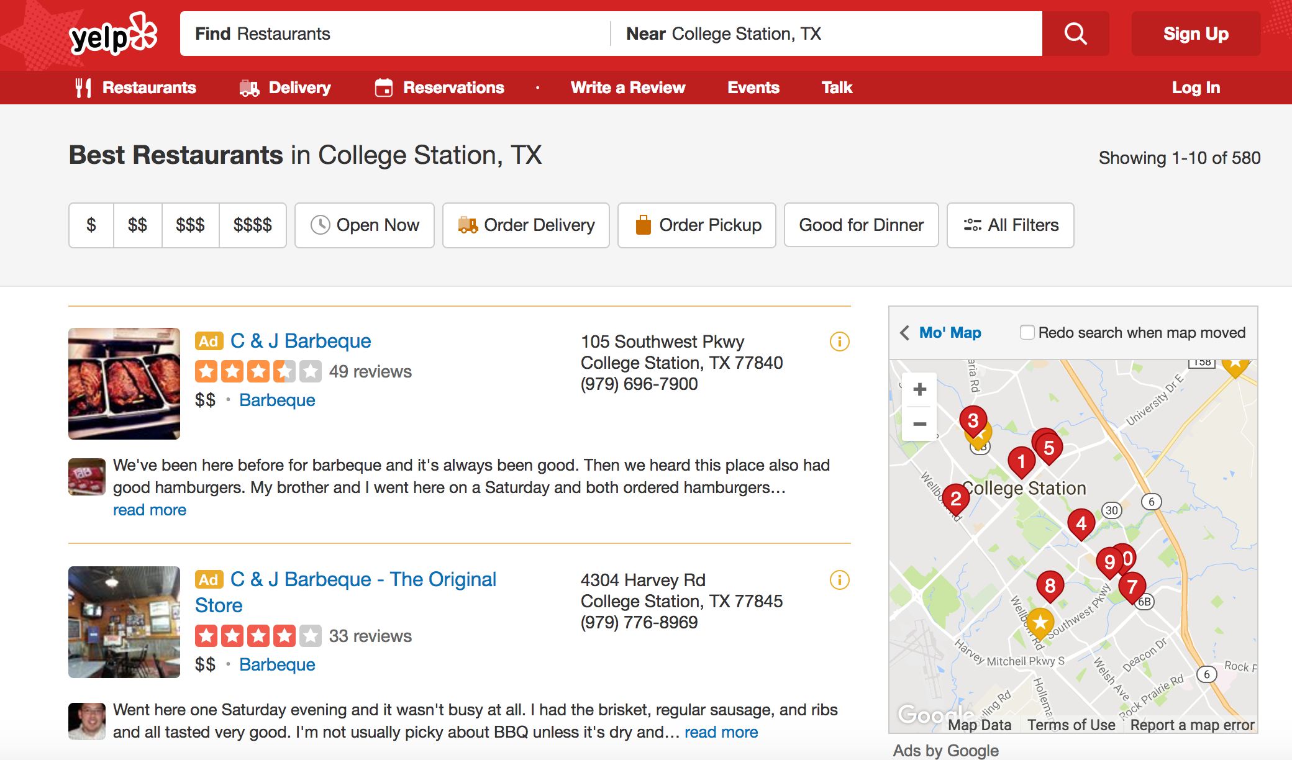

Slide 2
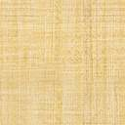
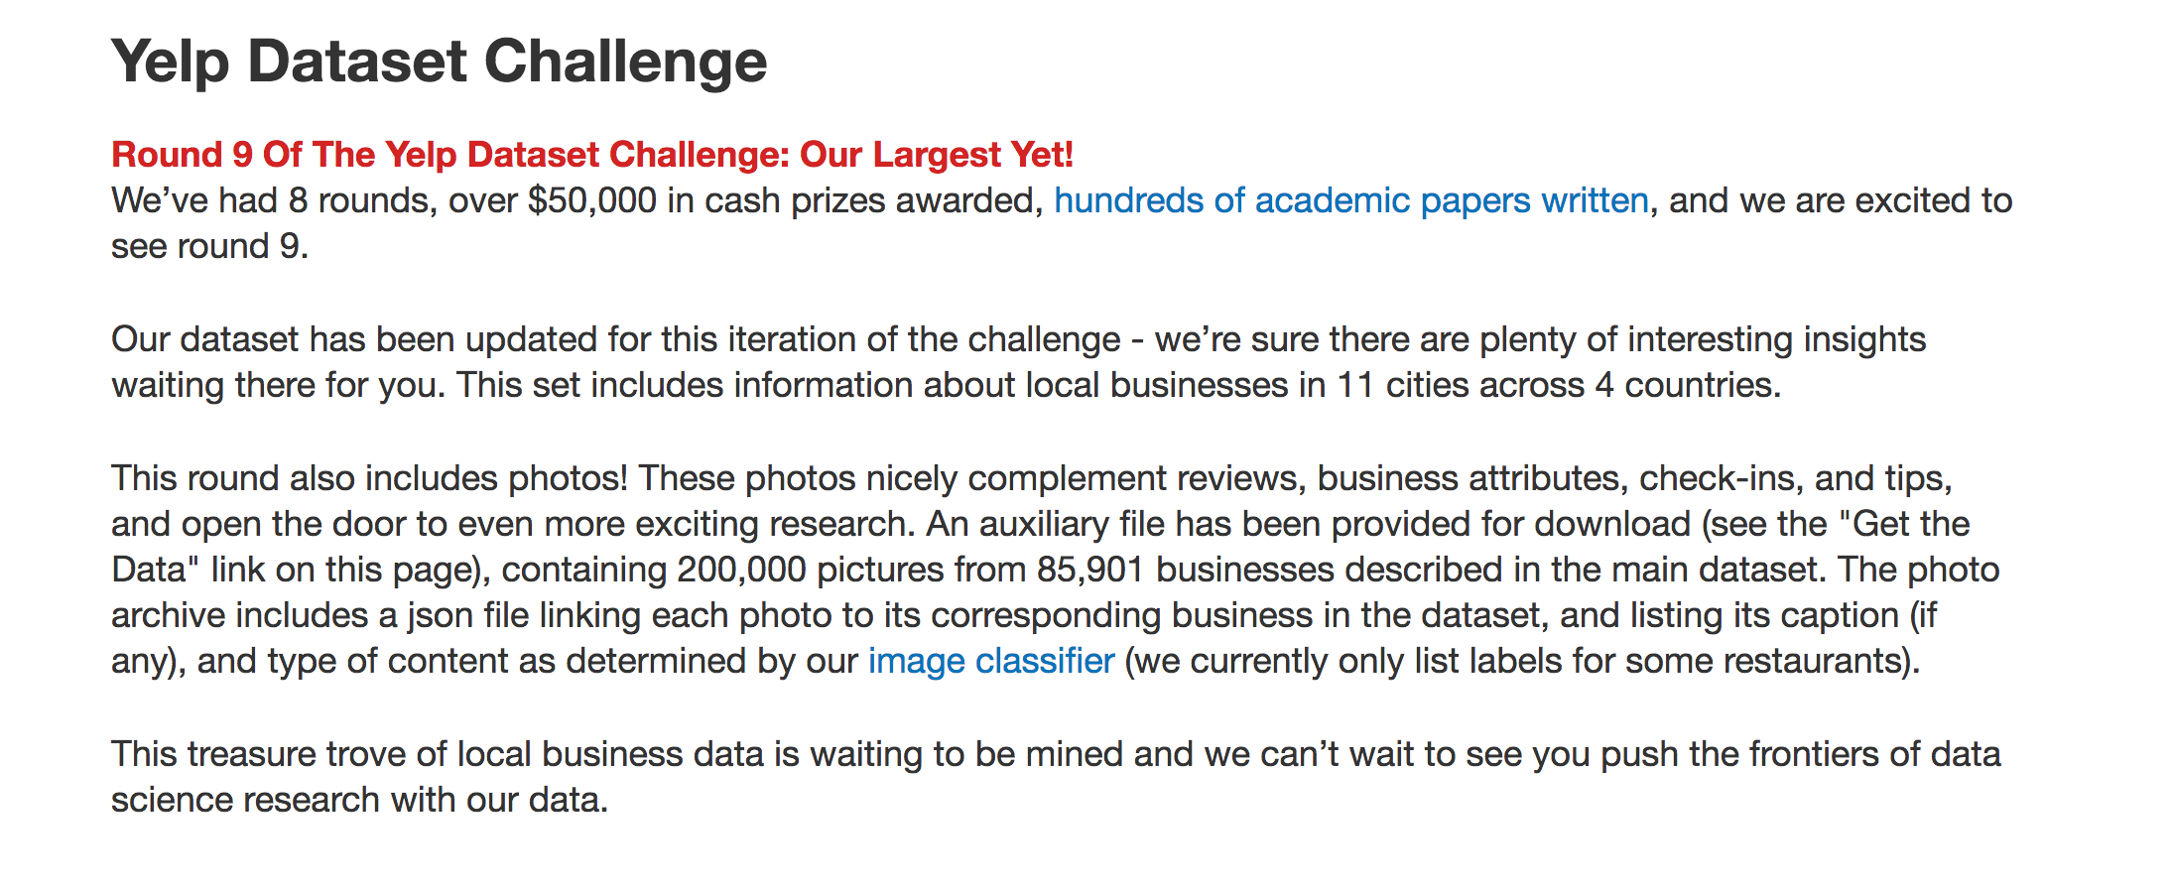

Slide 3
Overall Structure
Basic MF
Data Pre-processing
Social MF
Combination
Topic MF

Slide 4
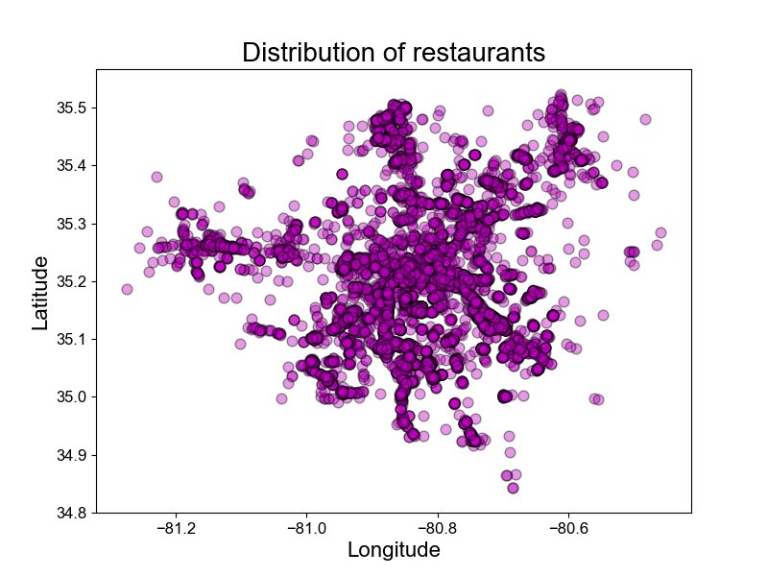
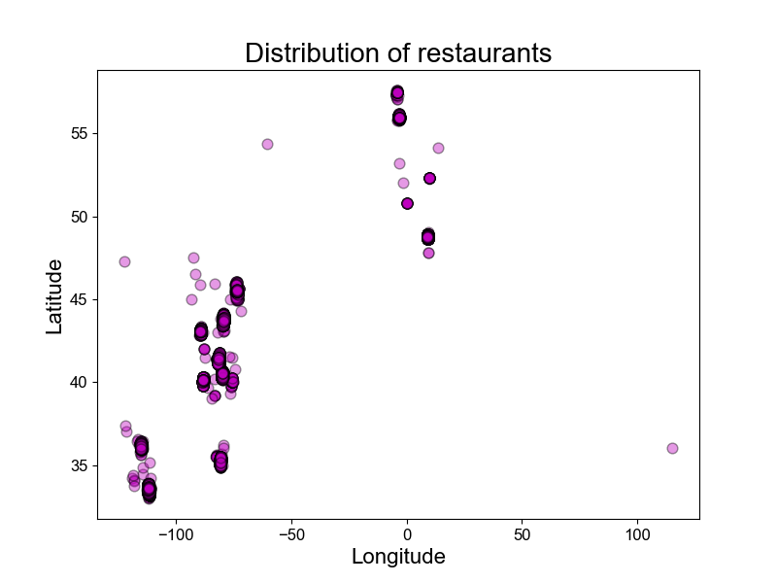

Slide 5
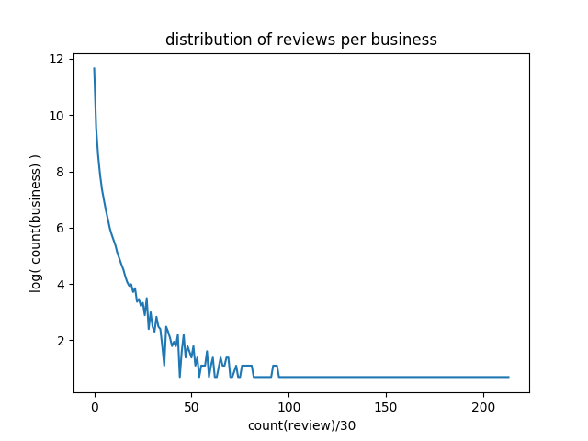
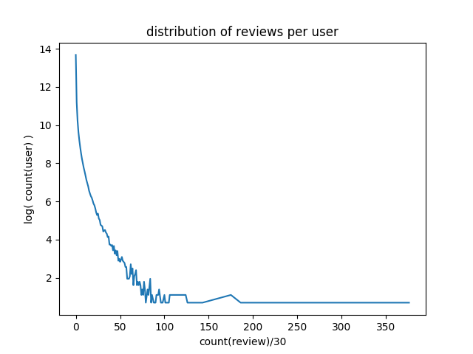

Slide 6
Paper & Related Work

Slide 7
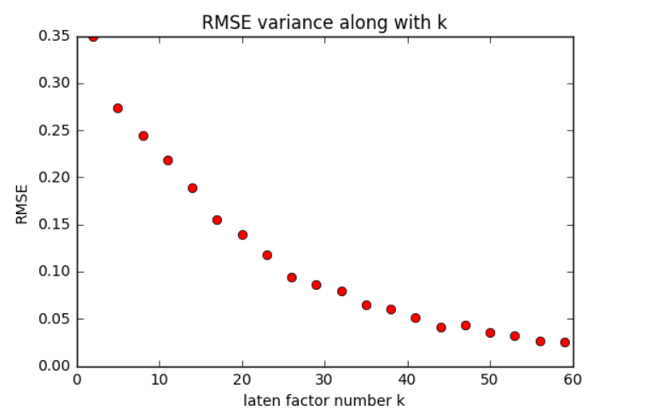

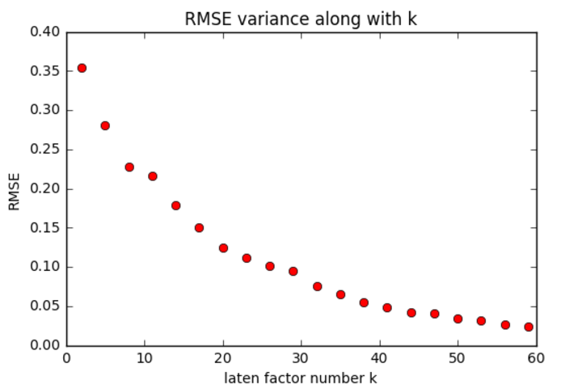

Basic MF
Basic MF uses SVD method to deposit the rating matrix into U*V
Predict unknown rating by U*V
The latent factor number K chosen 30

Slide 8
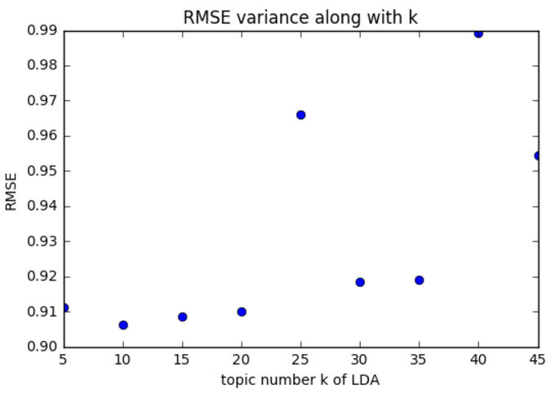
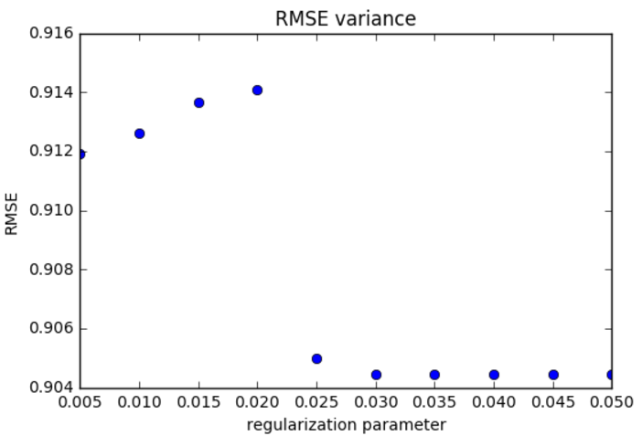

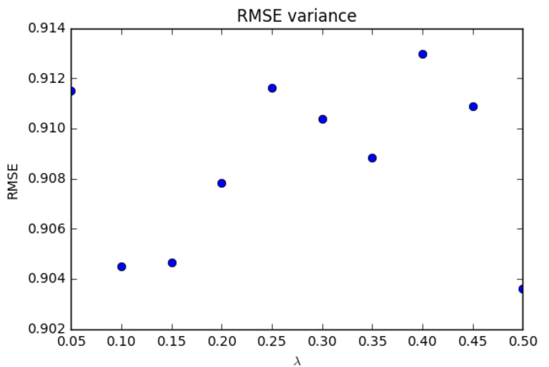
Topic MF
To get the topic distribution of reviews and words, LDA (Latent Dirichlet Allocation) is used
The model is trained as:
Result after parameter adjust, 0.907157138867

Slide 9
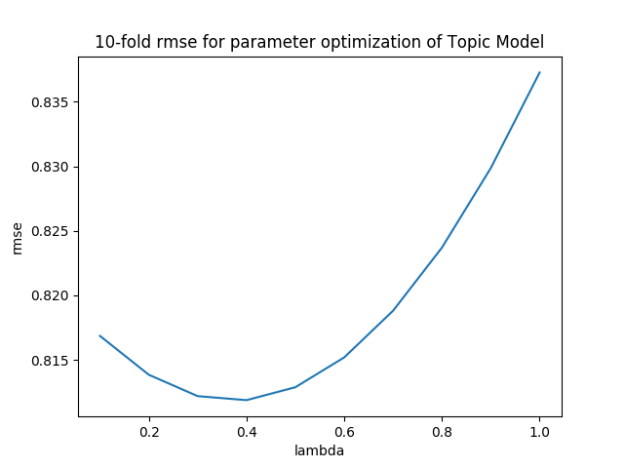
Pre-processed all reviews
For each business, we grouped all its reviews in training data as bag-of-words, and then use the LDA library to calculate the topic distribution for each business.
For each user, we calculate his/her topic rating using linear regression based on his/her real-ratings in training data subtract Ubb.

Slide 10

Social MF
Users are likely to ask for suggestions from their local friends
Users tend to seek suggestions from those with high reputations
Combined the two indication, social MF is modeled as:

Slide 11
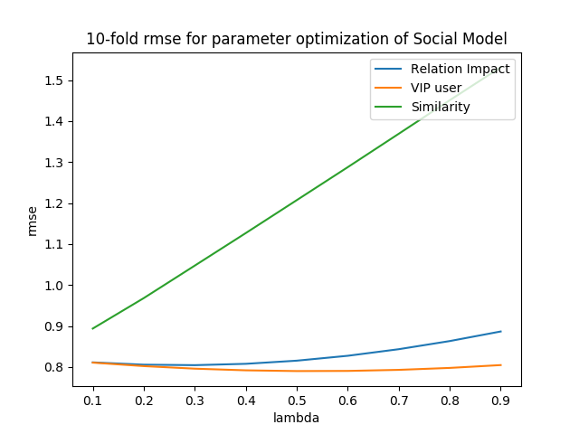
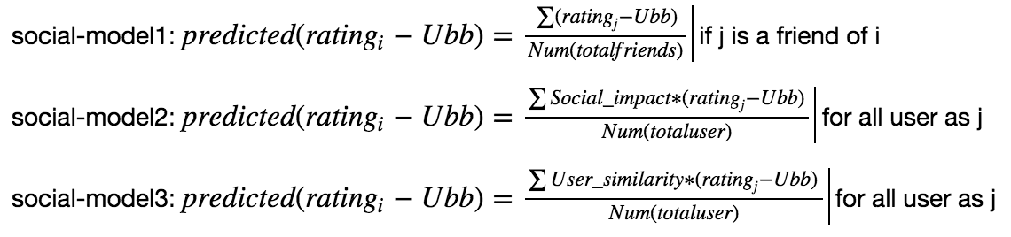

Slide 12
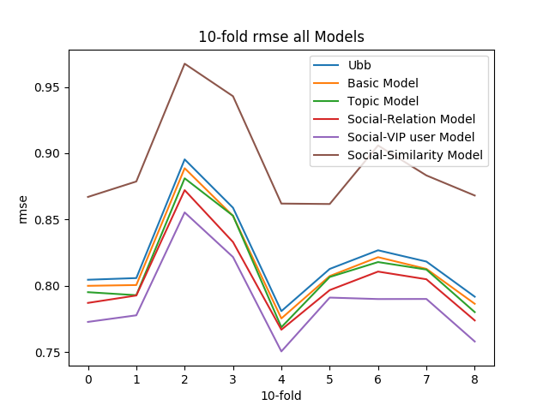
Result

Slide 13
Discussion
Our team first implement the paper work, which applies gradient derivation
As the result is not good enough, we did further work and implemented three advanced model.
Finally, ten-fold cross validation method is used for evaluation and turning parameters.

